Slide 1
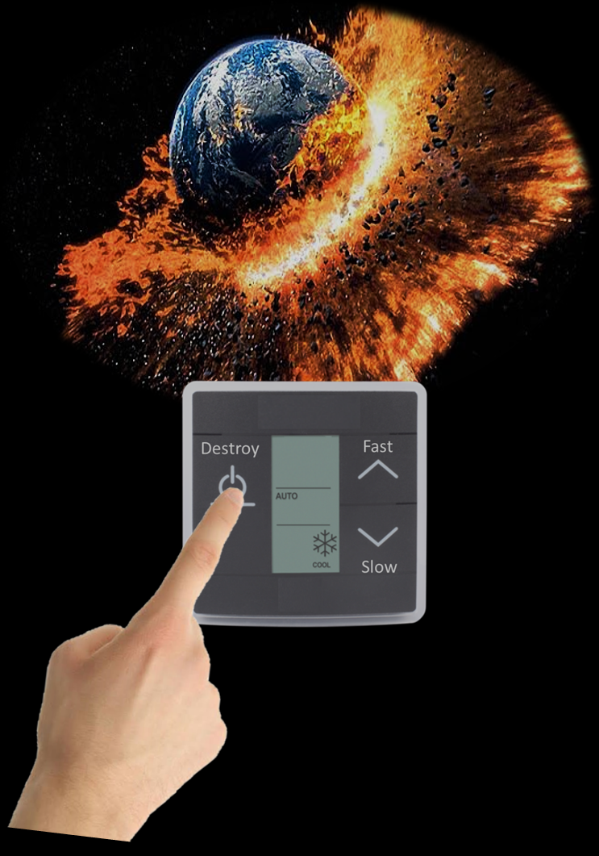
DENSO TURKEY, Quality Assurance & Engineering, Murat İşler
Posting period: （18.03.2020）

Slide 2
DENSO TURKEY, Quality Assurance & Engineering, Murat İşler
Posting period: （18.03.2020）

Slide 3
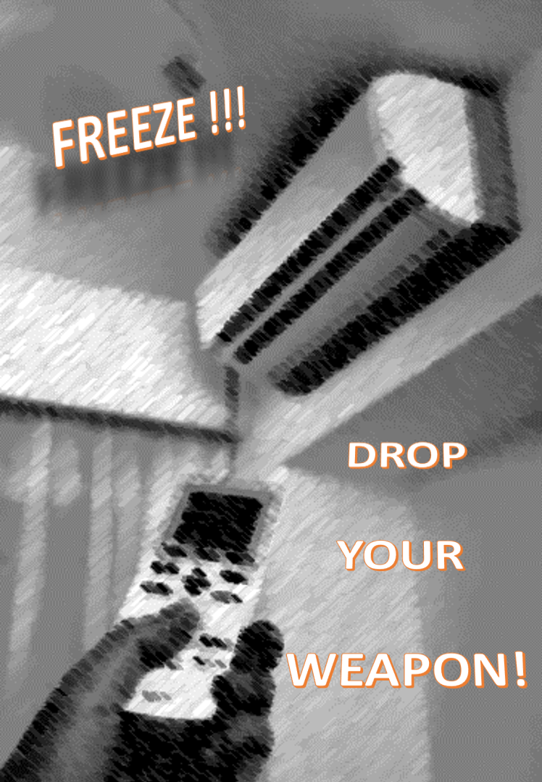
DENSO TURKEY, Quality Assurance & Engineering, Murat İşler
Posting period: （18.03.2020）

